Slide 1

TANSTACK QUERY

Slide 2

TANSTACK QUERIES
QUERY
MUTATION
INVALIDATE
A query is a declarative dependency on an asynchronous source of data that is tied to a unique key. A query can be used with any Promise based method (including GET and POST methods) to fetch data from a server
Mutations are typically used to create/update/delete data or perform server side-effects. For this purpose, TanStack Query exports a useMutation hook.
In React Query, invalidating a query means marking it as "stale," which tells React Query that the data associated with that query is potentially outdated and should be re-fetched.

Slide 3
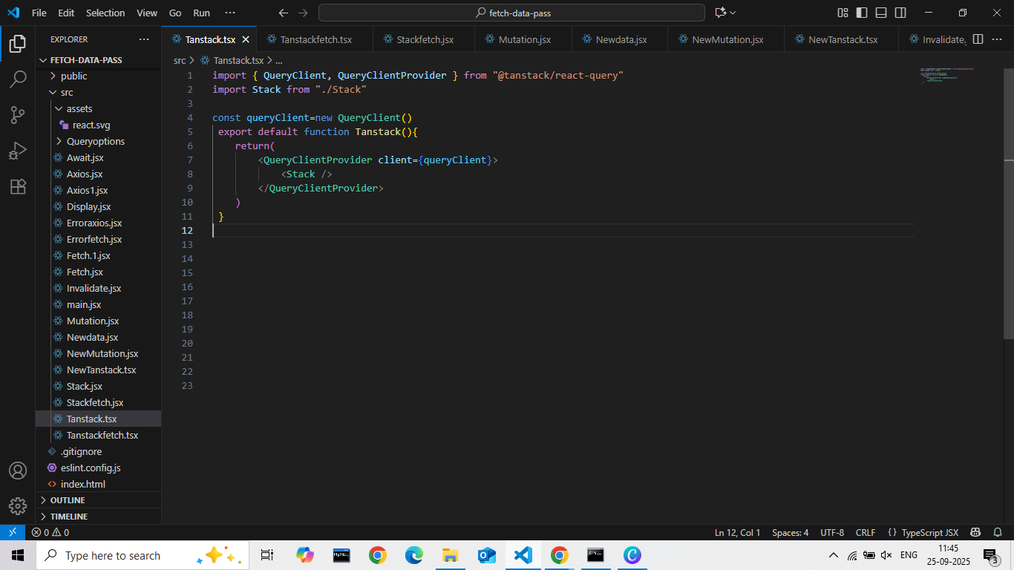
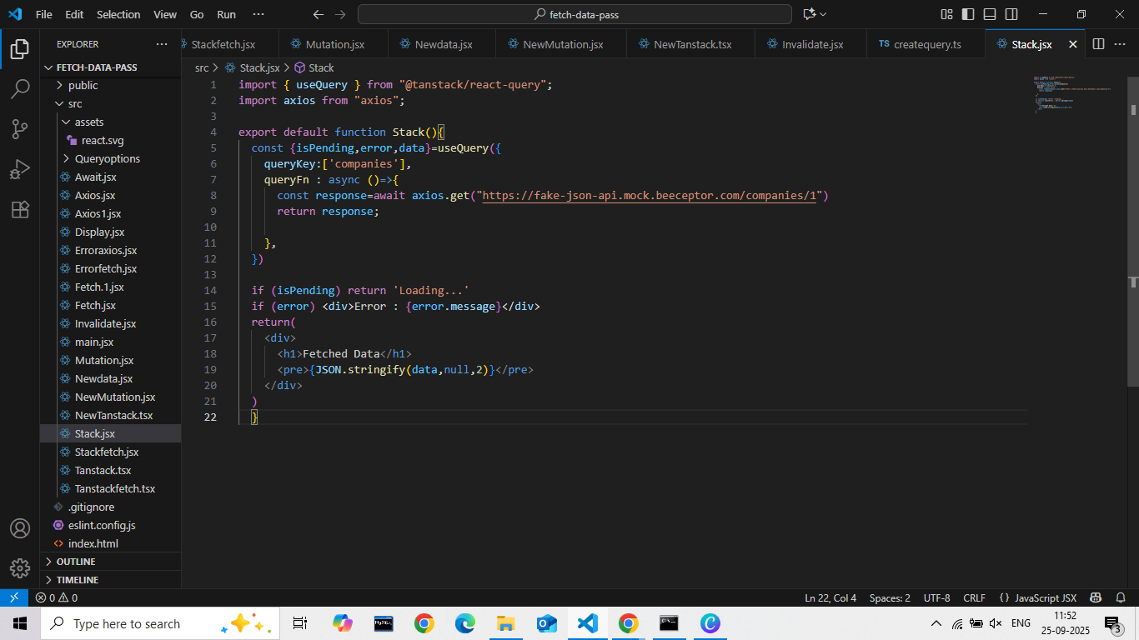
EXAMPLE OF TANSTACK QUERY

Slide 4
FETCHING API
FETCH
AXIOS
TANSTACK QUERY
Fetching data in React applications often involves using the fetch API, a native JavaScript interface for making HTTP requests
Axios is a popular, promise-based HTTP client used in React applications to make asynchronous requests to APIs or other backend services
TanStack Query, formerly known as React Query, is a powerful data-fetching library for React applications.
The process of fetch ,caching and updating

Slide 5

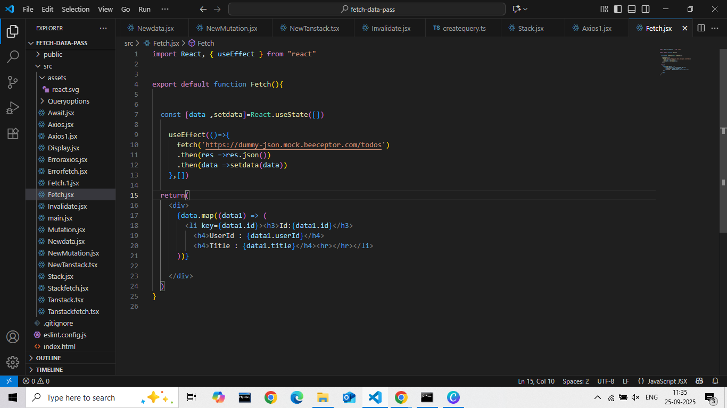
EXAMPLE OF FETCH DATA

Slide 6
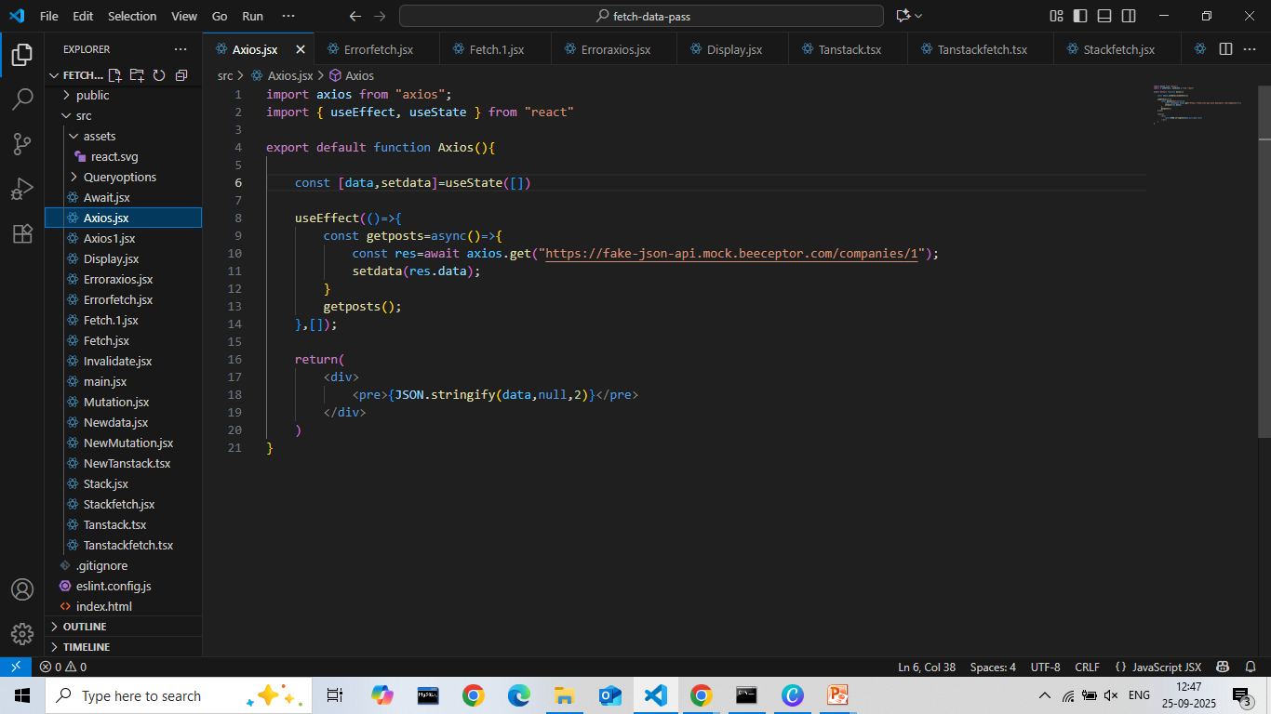
EXAMPLE OF AXIOS

Slide 7
\
Background sync in React, particularly within Progressive Web Apps (PWAs), enables web applications to defer actions, such as sending data to a server, until the device has a stable network connection. This ensures a more robust and offline-capable user experience.
Background Sync

Slide 8
\
Handling loading, error, and success states in a React component using useQuery from React Query involves destructuring the relevant properties returned by the hook.
The most common ones for handling loading, error, and success are:
isLoading or isPending : A boolean indicating if the query is currently fetching data for the first time. isPending is the newer, preferred term.
isError : A boolean indicating if the query encountered an error.
Error : Contains the error object if isError is true.
Handling Error, Loading, Success

Slide 9
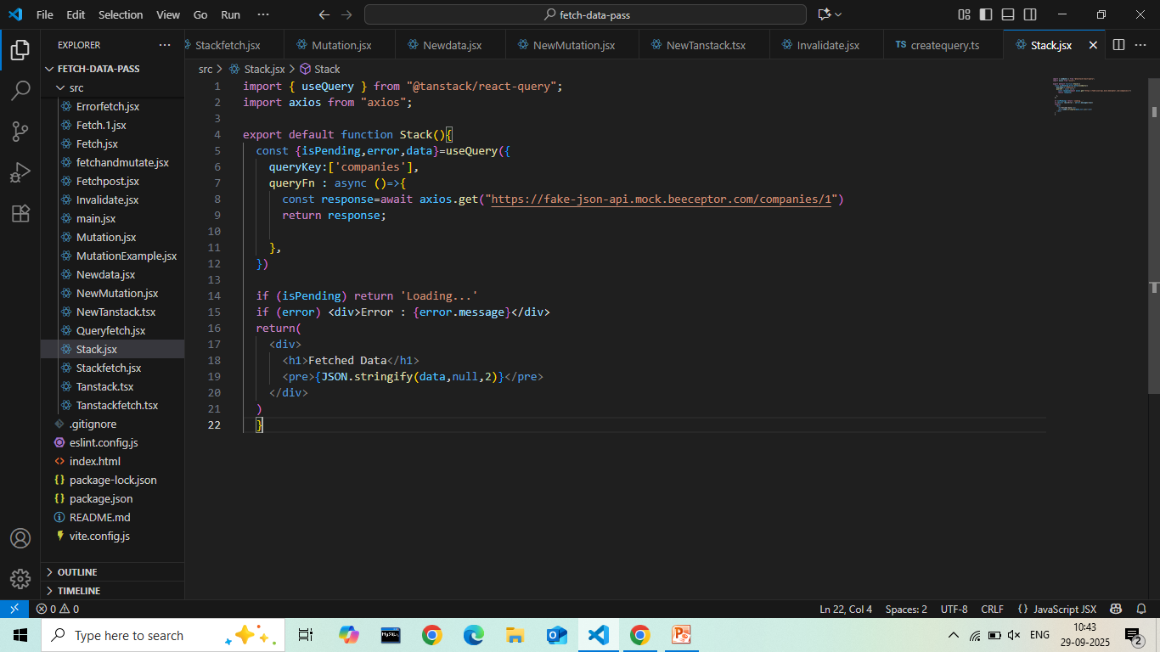
EXAMPLE OF
Handling Error, Loading
Success

Slide 10
Stale Time | Cache Time
Definition: Stale time defines how long data is considered "fresh" or valid before it needs to be re-fetched or revalidated from its source. | Definition: Cache time (or gcTime) determines how long data remains in the cache after it becomes unused (i.e., no longer actively observed or referenced by any part of the application).
Purpose: It dictates when a cached item should be considered potentially outdated. Once the stale time expires, the data is marked as stale, and subsequent requests for that data will trigger a re-fetch or revalidation attempt to ensure data currency. | Purpose: It manages the memory footprint of the cache by specifying when inactive data should be eligible for garbage collection and removal from memory
Impact: A shorter stale time means data is refreshed more frequently, ensuring higher data accuracy but potentially leading to more network requests. A longer stale time reduces network requests but increases the risk of serving outdated information. | Impact: A shorter cache time frees up memory more quickly but might require re-fetching data if it's needed again shortly after becoming inactive. A longer cache time keeps data readily available for longer but consumes more memory.
Behavior: Serves cached data, and if stale, triggers an immediate background refetch upon a new query. | Behavior: Deletes inactive data completely from the cache after the time limit expires.

Slide 11

THANK YOU

